Slide 1
Review Quiz Last Week

Slide 2
Assignment 2 Solution

Slide 3
Don’t forget to do the quizzes

Slide 4
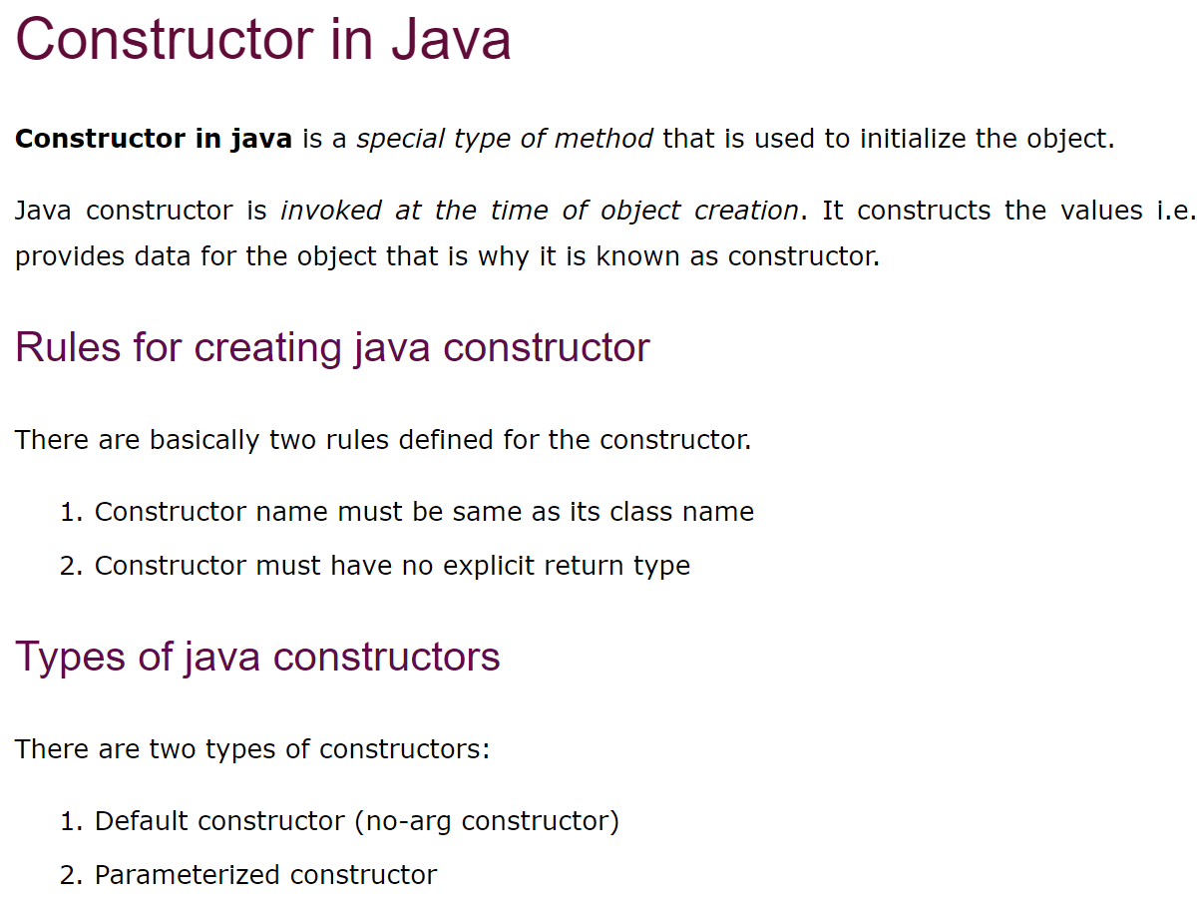
Review of Constructor

Slide 5
Lecture 2
Sorting

Slide 6
Recursive Algorithms
A recursive algorithm is an algorithm that breaks the problem into smaller sub problems and applies the algorithm itself to solve the smaller sub problems.
Because a problem cannot be endlessly divided into smaller sub problems, a recursive algorithm must have a base case:
A case where a recursive algorithm completes without applying itself to a smaller sub problem.

Slide 7
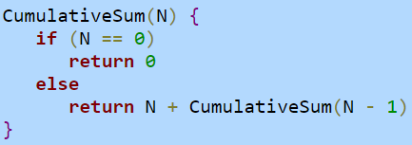
Recursive Algorithms
Algorithm to sum all positive integers less than or equal to a given number
Example:
If the initial call to the algorithm was N=5, the result would equal 5 + 4 + 3 + 2 + 1 + 0 which is 15

Slide 8
Selection Sort
Sorting method that treats the input as a sorted part and an unsorted part
Repeatedly selects the proper next value to put in the sorted part
Can be either the lowest or highest value
Elements to the left of “i” are sorted and elements to the right of “i” are unsorted
All elements on the right side are scanned to find the next value to add to the left side

Slide 9
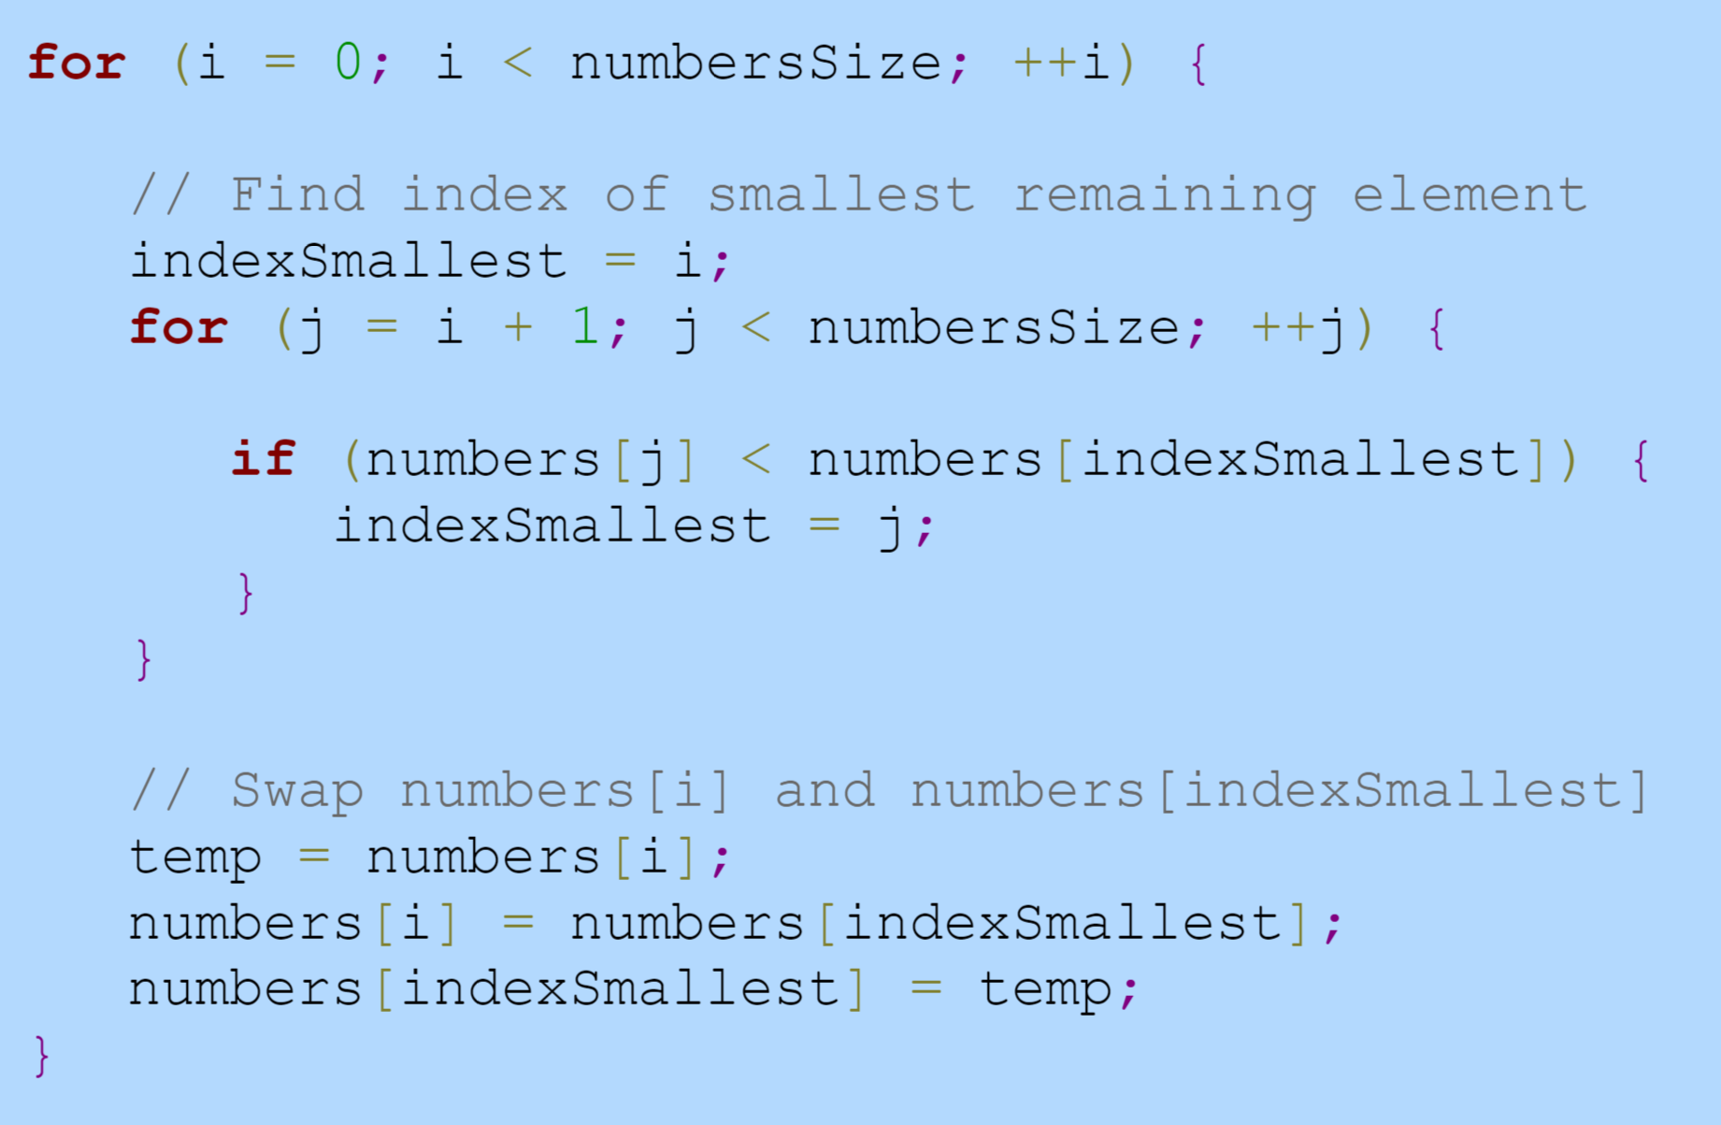
Selection Sort

Slide 10
Selection Sort
Outer loop runs N times
Inner loop runs an average of N/2 times
Total number of comparisons N * N/2
O(N^2)
Simple to code but not as fast as other sorting methods

Slide 11
Insertion Sort
The left side of array is the sorted part and the right side is the unsorted part, similar to selection sort
Selects the first element in the unsorted part and then keeps swapping it left in the sorted part until it’s in the right place
Does a similar swapping methodology to a bubble sort
Once a equal or smaller value is found, the element is in the right place

Slide 12
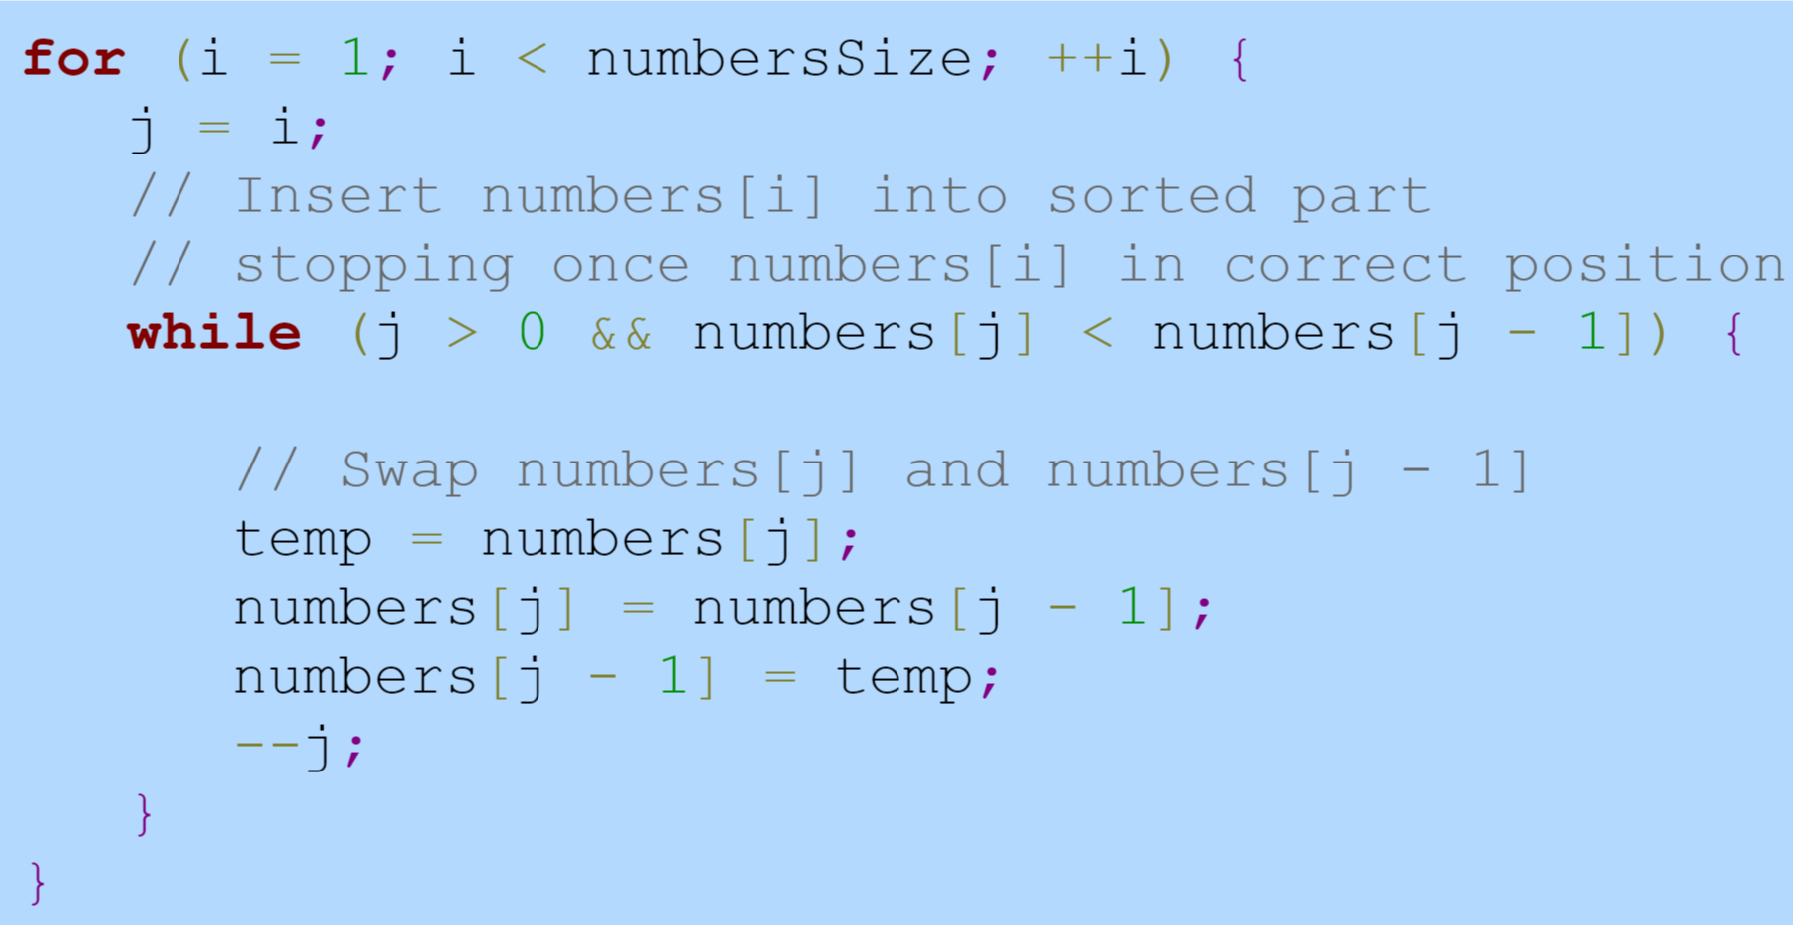
Insertion Sort

Slide 13
Insertion Sort
Outer loop runs N-1 times
Inner loop runs an average of N/2 times
Total comparisons proportional to: (N-1) * N/2
Big O Notation: O(N^2)
For a nearly sorted list, runtime becomes O(N)
Generally, insertion sort is faster for a “more sorted” list

Slide 14
Selection Sort vs. Insertion Sort
Usually insertion sort will perform less comparisons than selection sort, depending on the “sortedness” of the array
Selection sort must scan the remaining parts of the array when placing an element
Insertion sort only scans as many elements as necessary.
If the array is already sorted or almost sorted, Insertion sort performs in O(n) time
One advantage of Selection sort is that the number of swaps is O(n), while insertion sort is O(n^2)
Might be important if swap operations are happening on flash memory and need to be minimized

Slide 15
Quick Sort
Picks the middle element as the dividing line or “pivot”
Starts the boundaries on the first and last elements in array and checks if they are less than and greater than pivot, respectively
If they are, does nothing and moves the boundaries inward towards the pivot
If they aren’t, they get swapped
Called recursively until complete

Slide 16
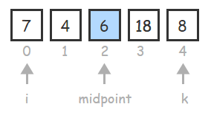
Quick Sort

Slide 17
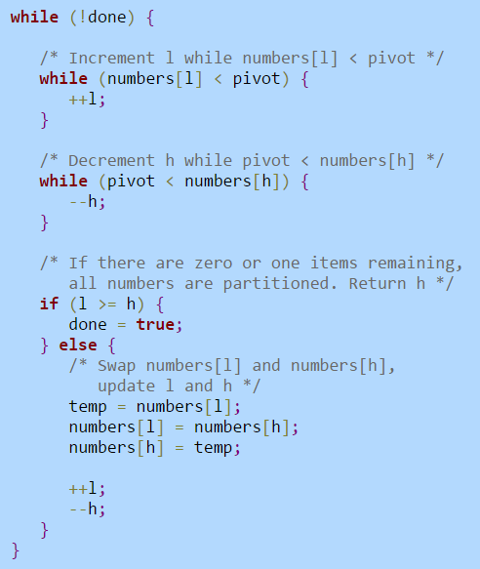
Quick Sort

Slide 18
Quick Sort
A good case will be a partially sorted list where the left and right partitions are close to the same size
A good case (partially sorted), Quicksort runtime will typically be:
O(N * logN)
A bad case where the partitions have very different sizes, runtime can be worse:
O(N^2)

Slide 19
Break Time?

Slide 20
Merge Sort
Keeps splitting the array in half and the merges them back together in sorted order
Another recursive sorting method
Runtime: O(N*logN)
Requires N additional memory elements for temporary array

Slide 21
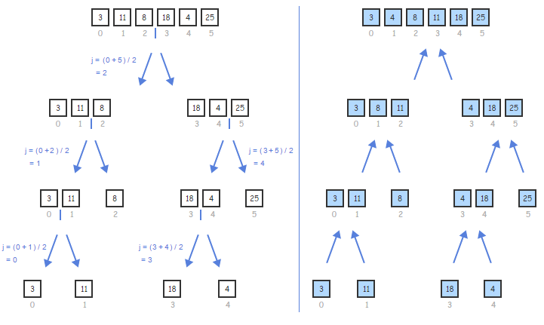
Merge sort

Slide 22
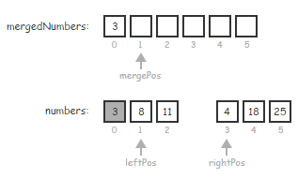
Merge Sort

Slide 23
Quick Sort vs. Merge Sort
Quick sort is usually preferred
Pivot point optimizations can improve performance
Quick sort is more “cache friendly”
Since only using one array, the same memory locations are accessed repeatedly and can be cached which results in a speed boost
Works well with arrays because it relies on fast direct access to elements
Doesn’t require allocating extra O(n) memory
Merge sort may be preferable if a stable sort is needed
i.e. Merge sort doesn’t reorder elements that are already sorted
Quick sort is non-stable and may reorder elements that are already sorted

Slide 24
What is a Stable Sort?
If you had a database of medical records and you wanted to sort the patient names by first AND last name
With a stable sort, you could sort the records by first name and then last name (the records would still stay in the same relative order of first name after sorting by last name.)
A non-stable sort only guarantees the current sorting criteria is satisfied
So a non-stable sort might disrupt the ordering of first names when it sorts the second time based on last names
This is due to the way the sorting algorithms are designed

Slide 25
Shell Sort
Treats the input as a collection of interleaved lists and sorts each list individually with a variant of insertion sort
A “gap value” is used to determine how many interleaved lists to use
For each interleaved list, if an element is at index “i”, the next element is at index “i + gap” value

Slide 26
Shell Sort
You can pick multiple gap values to run to increase performance
A common option is to choose powers of 2 minus 1, in descending order
Ex: For an array of size 100, gap values would be 63, 31, 15, 7, 3, and 1
Shell sort ends with a final gap value of 1, to finish with the regular insertion sort
This gap selection technique results in shell sort's time complexity being no worse than O(N^3/2)
However, Shell sort will correctly sort arrays using any positive integer gap values in any order, provided a gap value of 1 is included

Slide 27
Shell Sort vs. Regular Insertion Sort
Shell sort performs well when elements need to be moved large distances
An element get moved multiple indexes for each swap (depends on the gap value)
Example: a list of numbers is almost in increasing order except a couple of the lowest values are at the end
They’ll need to be swapped all the way to the beginning of the list

Slide 28
Zybooks Sections
1.7, 1.8, 1.10 – 1.15

Slide 29
Quiz This Week
Topic: Sorting
Due next Tuesday 11:59pm

Slide 30
Assignment This Week
Topic: Quicksort
Due next Tuesday 11:59pm

